Slide 1
NERS OPS PILOT
Notes:
https://deptapps.engin.umich.edu/ops/index/info?dept=227000

Slide 2
What is OPS?
What is your role as PI (aka Shortcode Owner)?
How will NERS utilize the OPS system.
How to submit a purchase request.
Workflow and Progress Tracking.
Questions (please hold all questions until the end) and Feedback.

Slide 3
What is OPS?
OPS (Online Purchasing System) is a web-based tool for managing purchasing and procurement workflow within a department or unit and is available to anyone who has a U-M uniqname and Kerberos password.

Slide 4
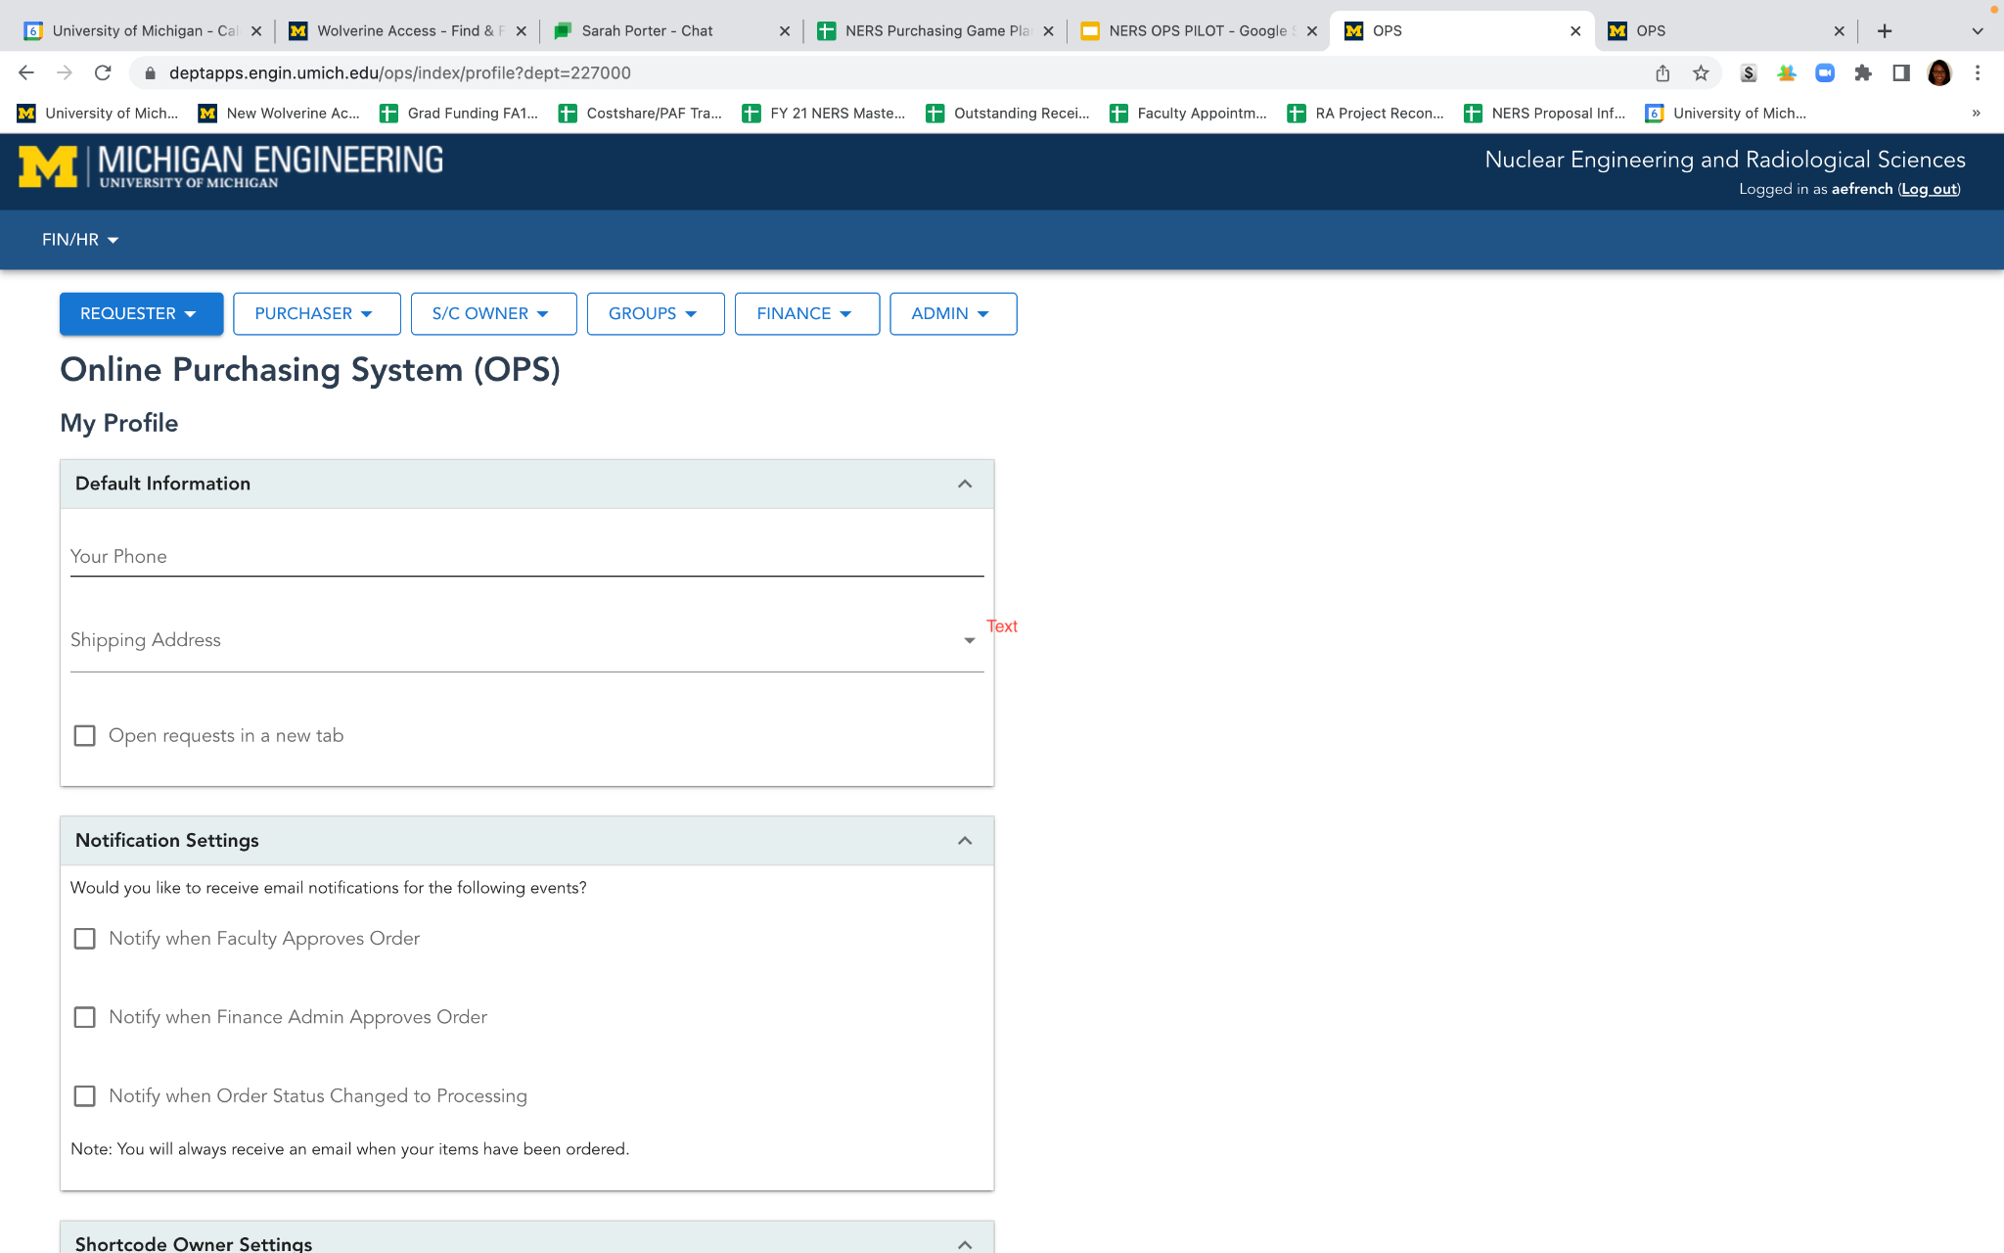
PROFILE SETUP
OPS SYSTEM
Notes:
Shortcode Owner - There is a way to set up your profile as a shortcode owner to waive request under a certain threshold or to designate all requests go to a designated person. However, for the pilot program, we’re encouraging everyone to not set these up yet so that you can have a feel for how the system works and the notifications you will receive.

Slide 5

OPS ROLES
REQUESTER - The person who needs to purchase goods or services. Anyone with access to NERS OPS system with a uniqname and Kerberos password can be a requester.
SHORTCODE OWNER - This is a default role granted to the PI/CO-PI of a project. A request cannot be processed until the shortcode owner approves the request. Your approval signifies you agree with the purchase and the scientific relevance of the item(s) being purchased.
FINANCIAL APPROVER - This is your designated RA/SAPOC. They will be responsible for reviewing the request to make sure it is compliant with university policies and procedures, including the existence of funding for the purchase. A request cannot be processed until the financial approver approves the request.
PURCHASER - The person who processes the order. Typically Sarah Porter. Once the order is placed, the purchaser updates the status of the request, and the requestor is notified.

Slide 6
UTILIZING THE OPS SYSTEM

Slide 7
What to use the OPS System for:
Placing ANY orders (Purchase Orders with Quotes, Online Orders, Marketsite Orders)
Tracking the status of an order you placed
You CANNOT use the OPS System for submitting Reimbursements (submit reimbursements through the main office)

Slide 8
PLACING AN ORDER
NERS OPS

Slide 9
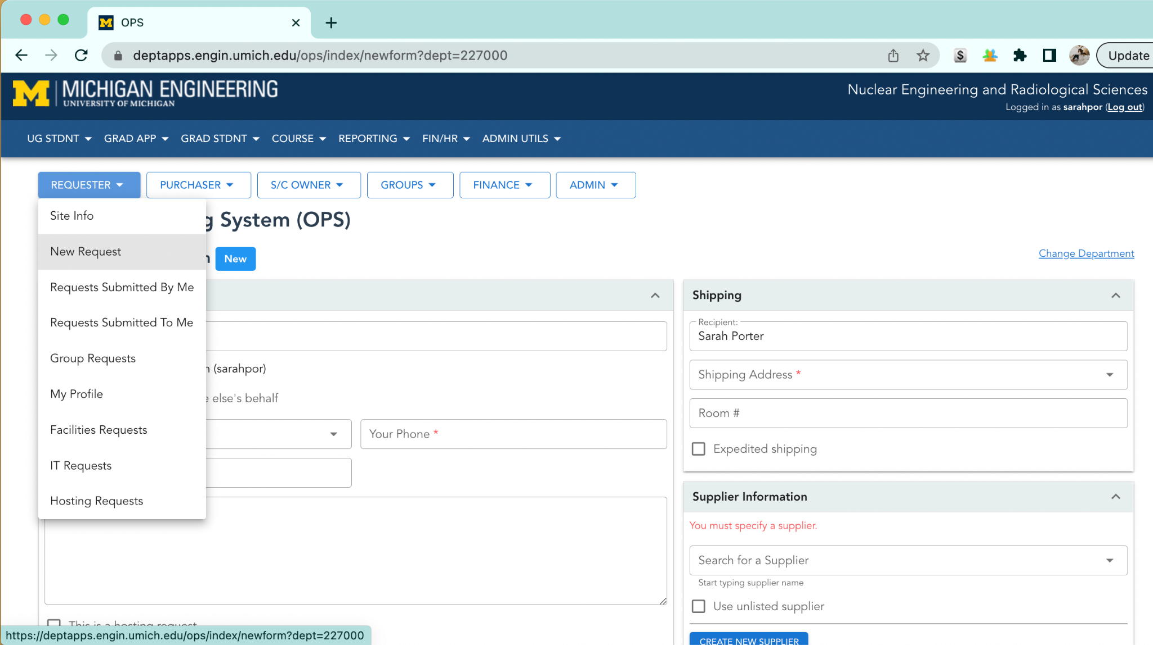

Slide 10
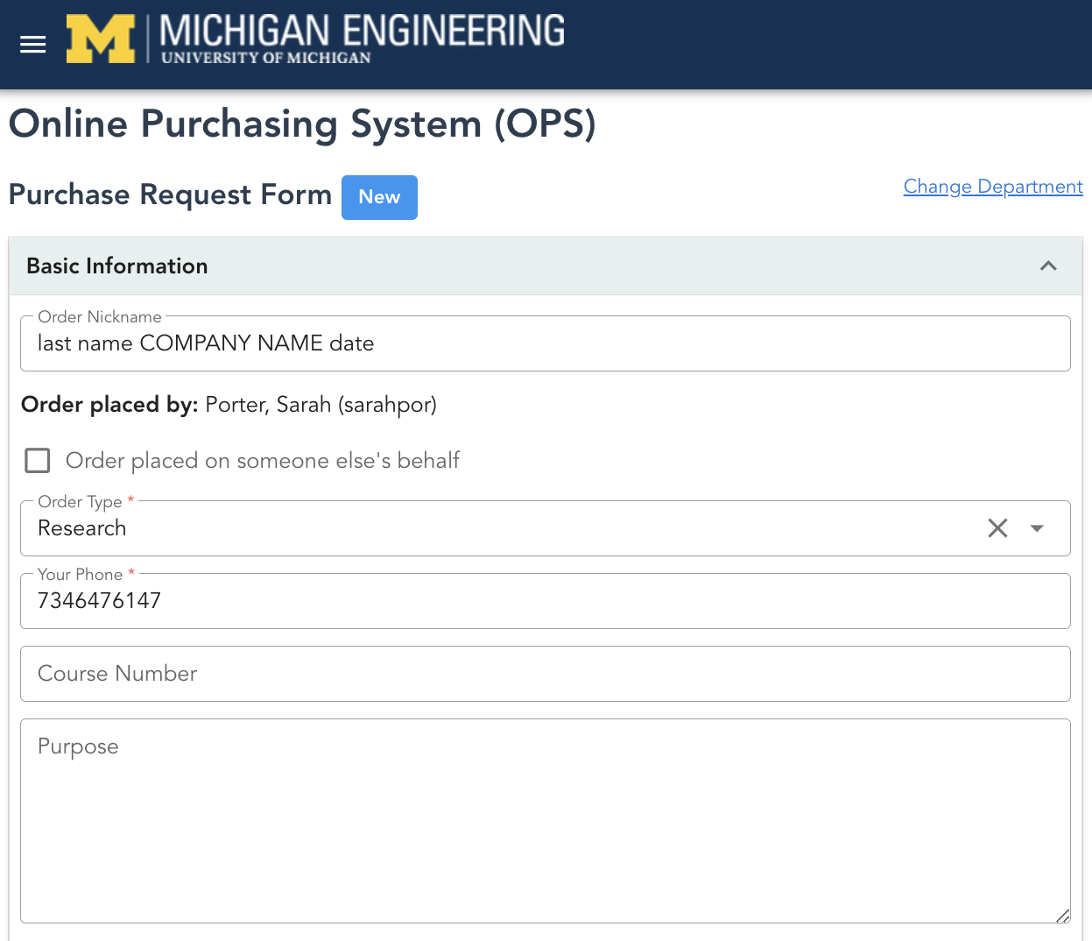

Slide 11
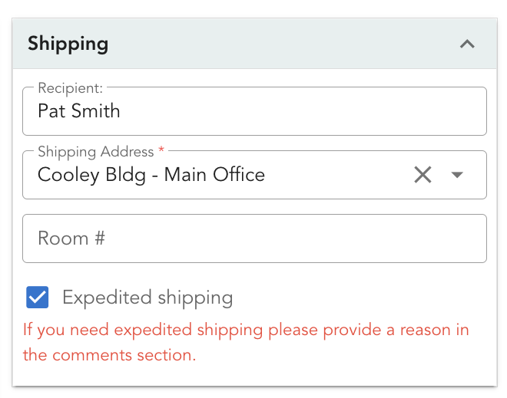

Slide 12
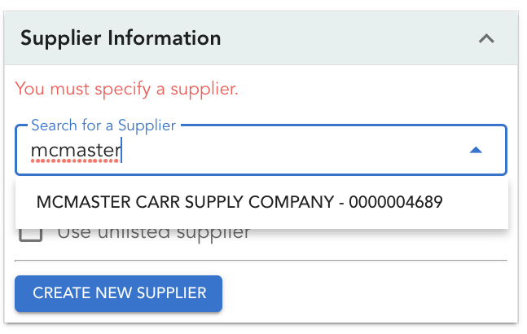

Slide 13
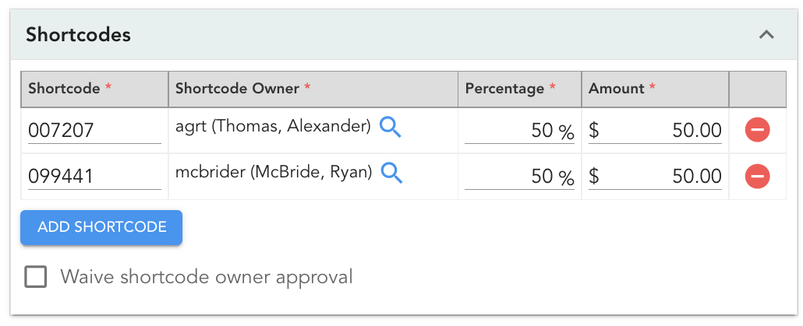

Slide 14
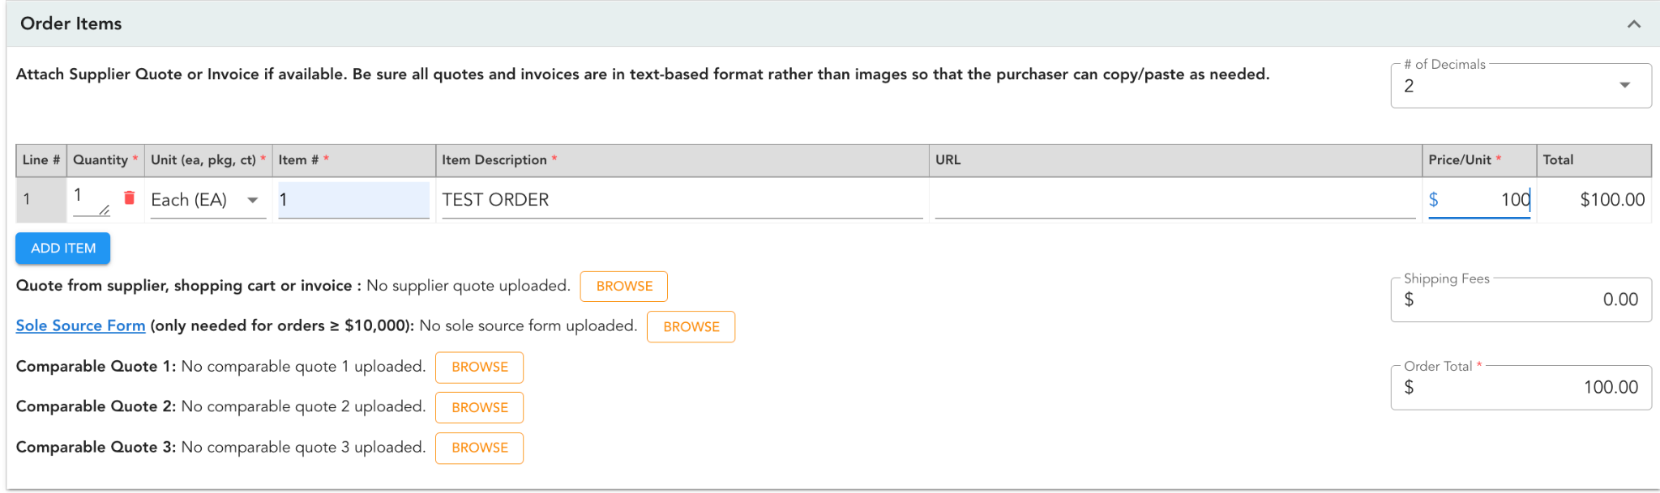

Slide 15
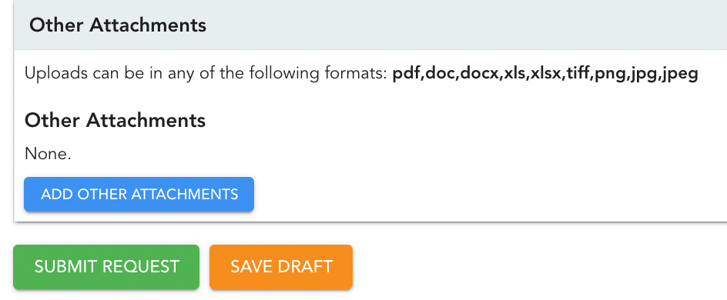

Slide 16
The
Basics
Enter Basic Information
order nickname, order type…
Enter Shipping Address
Select Supplier
Enter Shortcode information
Add line items
Upload Quote from Supplier
> SUBMIT REQUEST!

Slide 17
Marketsite Orders
Start request in NERS OPS
Enter basic info only, then save draft
Note OPS Ticket # (you'll add this to the Marketsite basket later)
Create an order in Marketsite
Assign Basket to Sarah Porter (sarahpor)
Save screenshot of cart (you'll attach this to the OPS order)
Go Back to OPS order
Attach cart image in the Attachments section of the OPS ticket
> Submit OPS Request

Slide 18
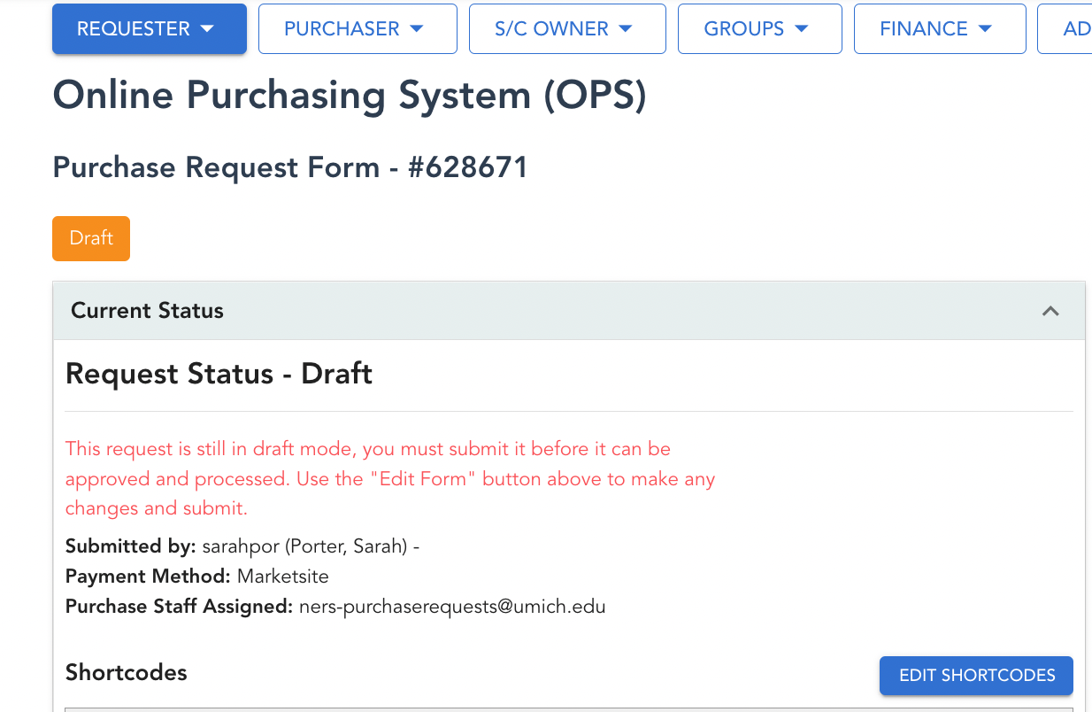

Slide 19
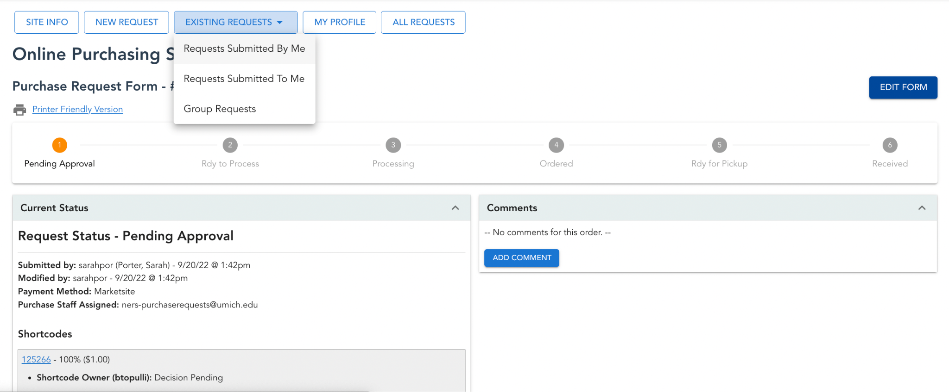

Slide 20
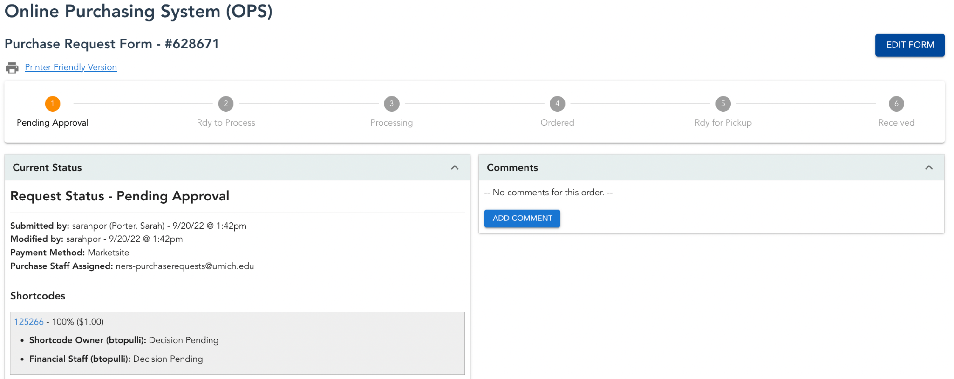

Slide 21
OPS FEEDBACK FORM

Slide 22
